Slide 1
Smart Medicare WebApp Glimpse
Aim is to build a centralized database so that we may accumulate all the patients medical history at a single place and medications and other treatments may be suggested by the doctor keeping in view all the things
We have given two options here where we may Register and LogIn either as a patient or a doctor and update all the relevant medical details
Main thing that is very important in such apps is the security, keeping security in mind we are trying to implement OTP service in a webapp where any who Register for the first time need to verify the Mobile number and Email ID using the OTP and for every next ogin another OTP is sent to avoid any data breach.

Slide 2
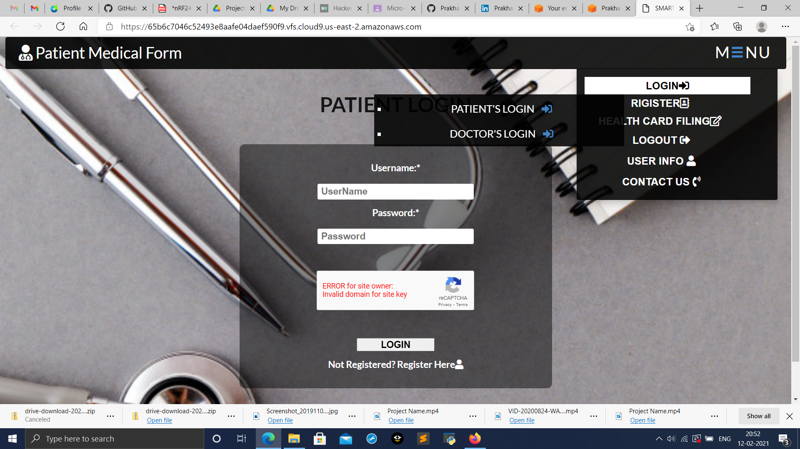

Slide 3
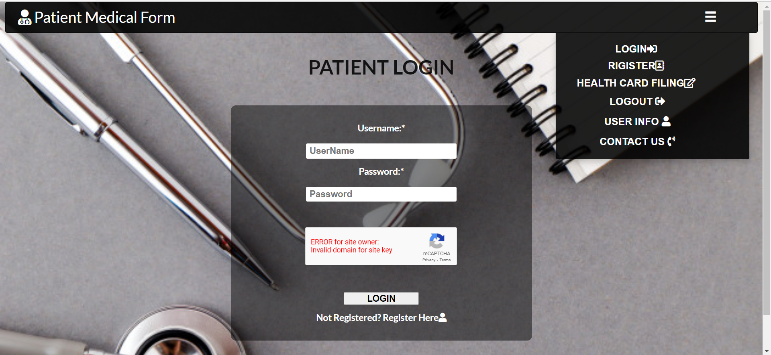

Slide 4
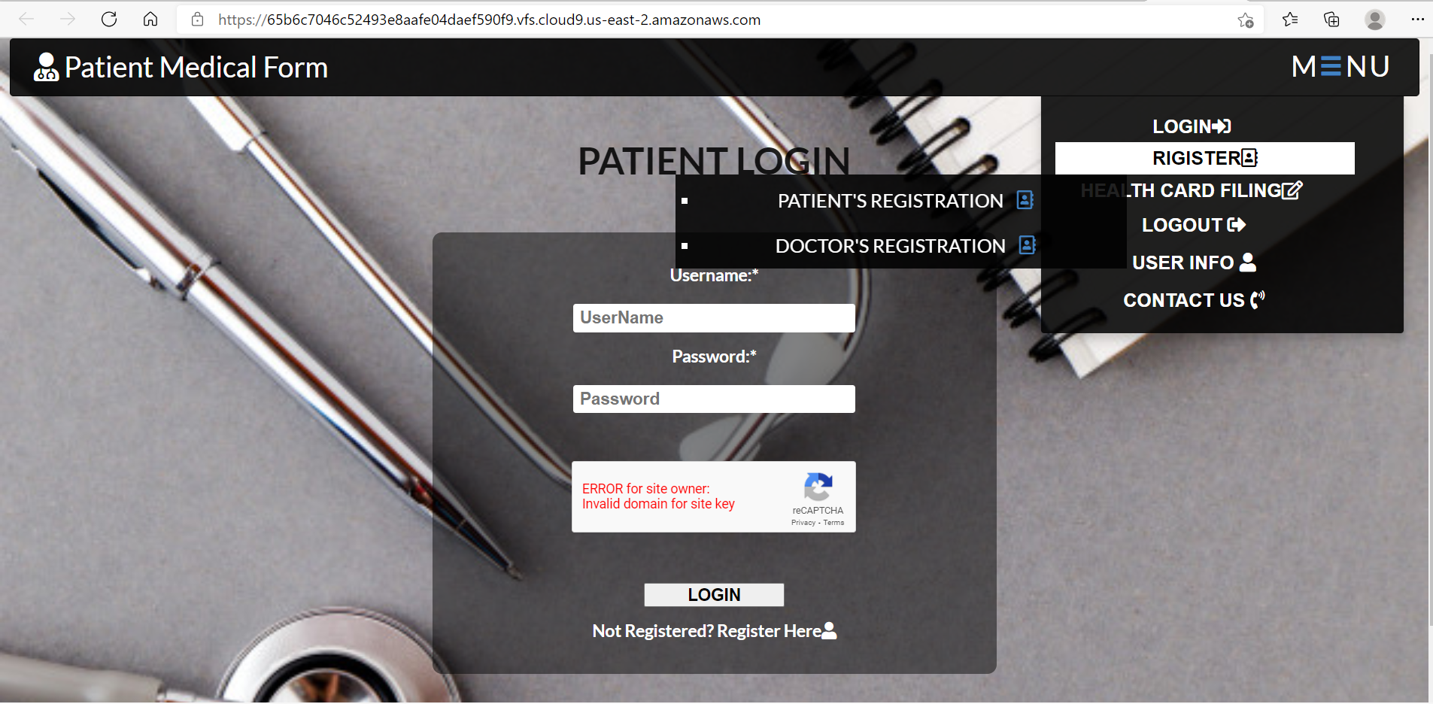

Slide 5
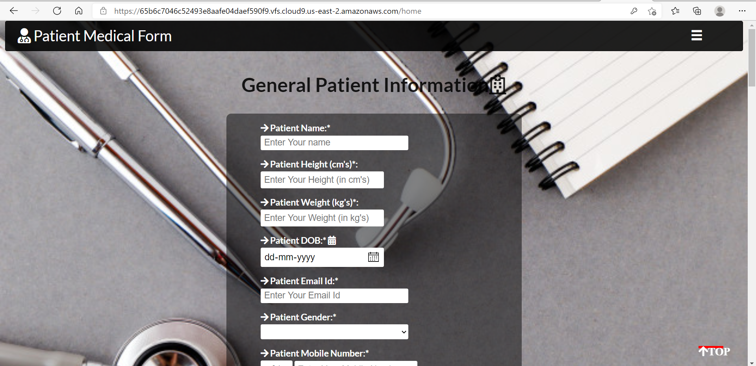

Slide 6
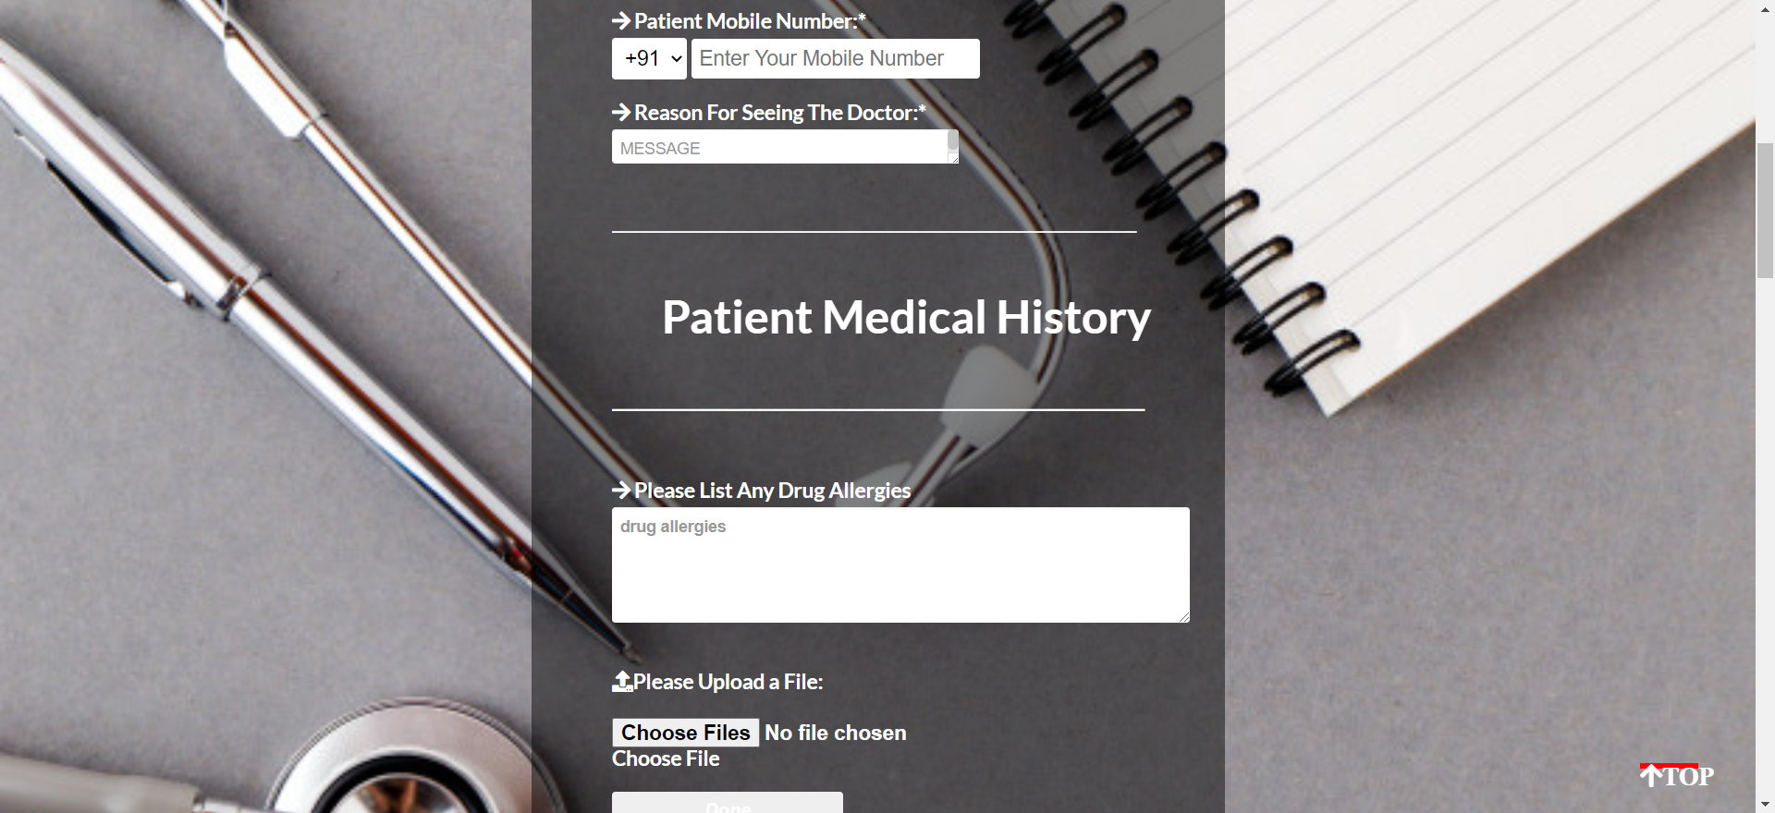

Slide 7
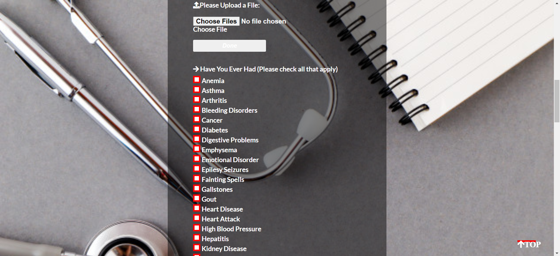

Slide 8
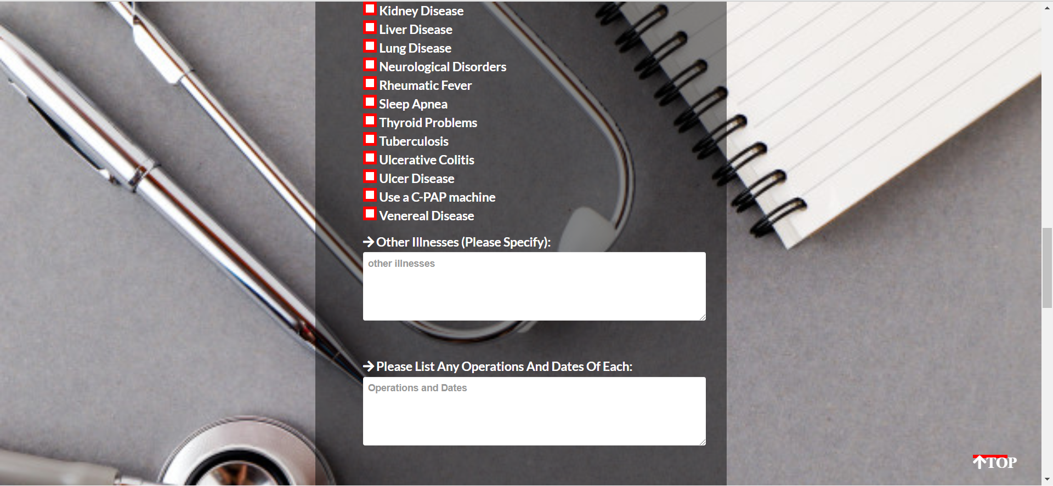

Slide 9
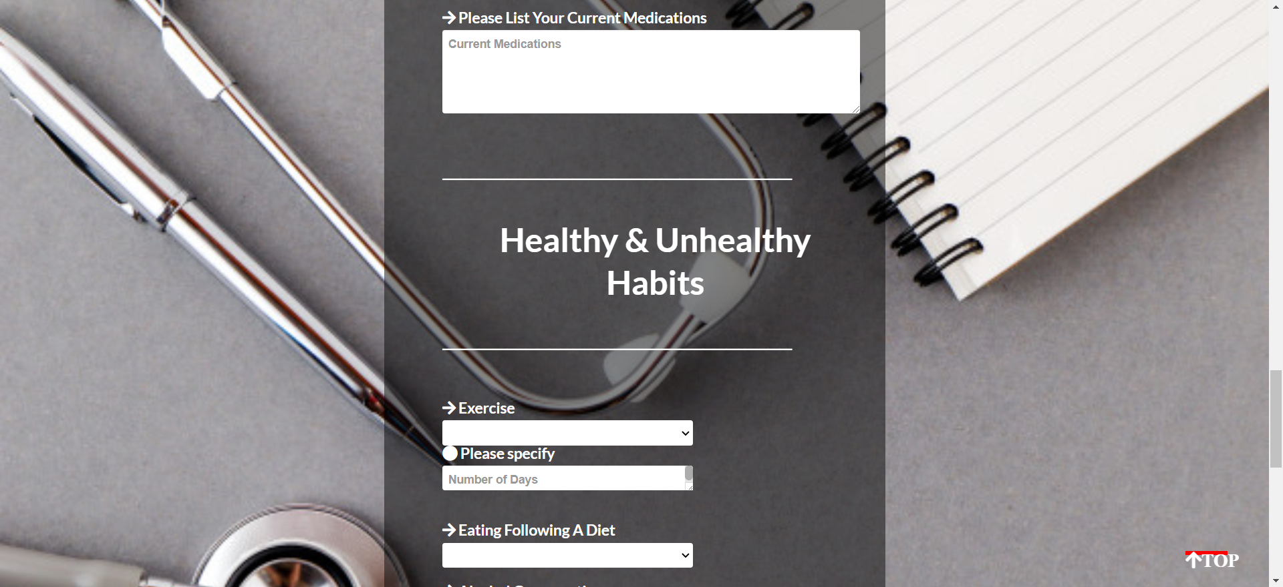

Slide 10
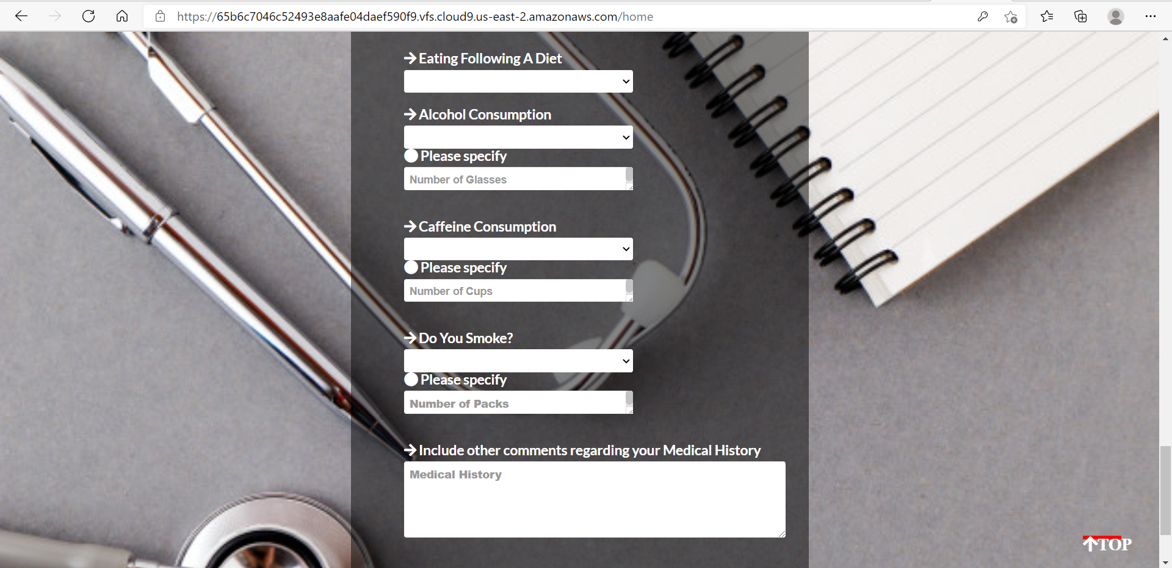

Slide 11
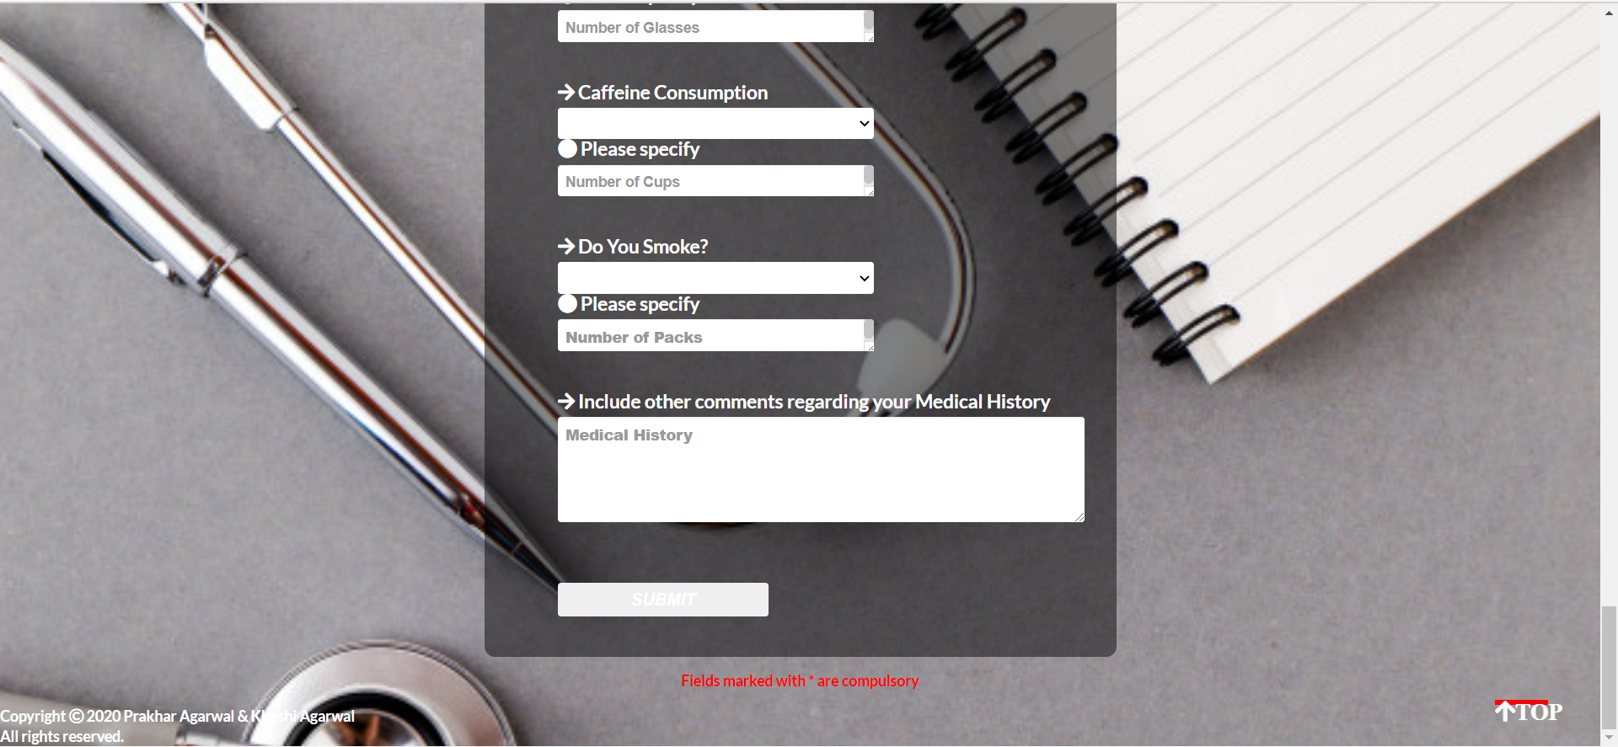

Slide 12
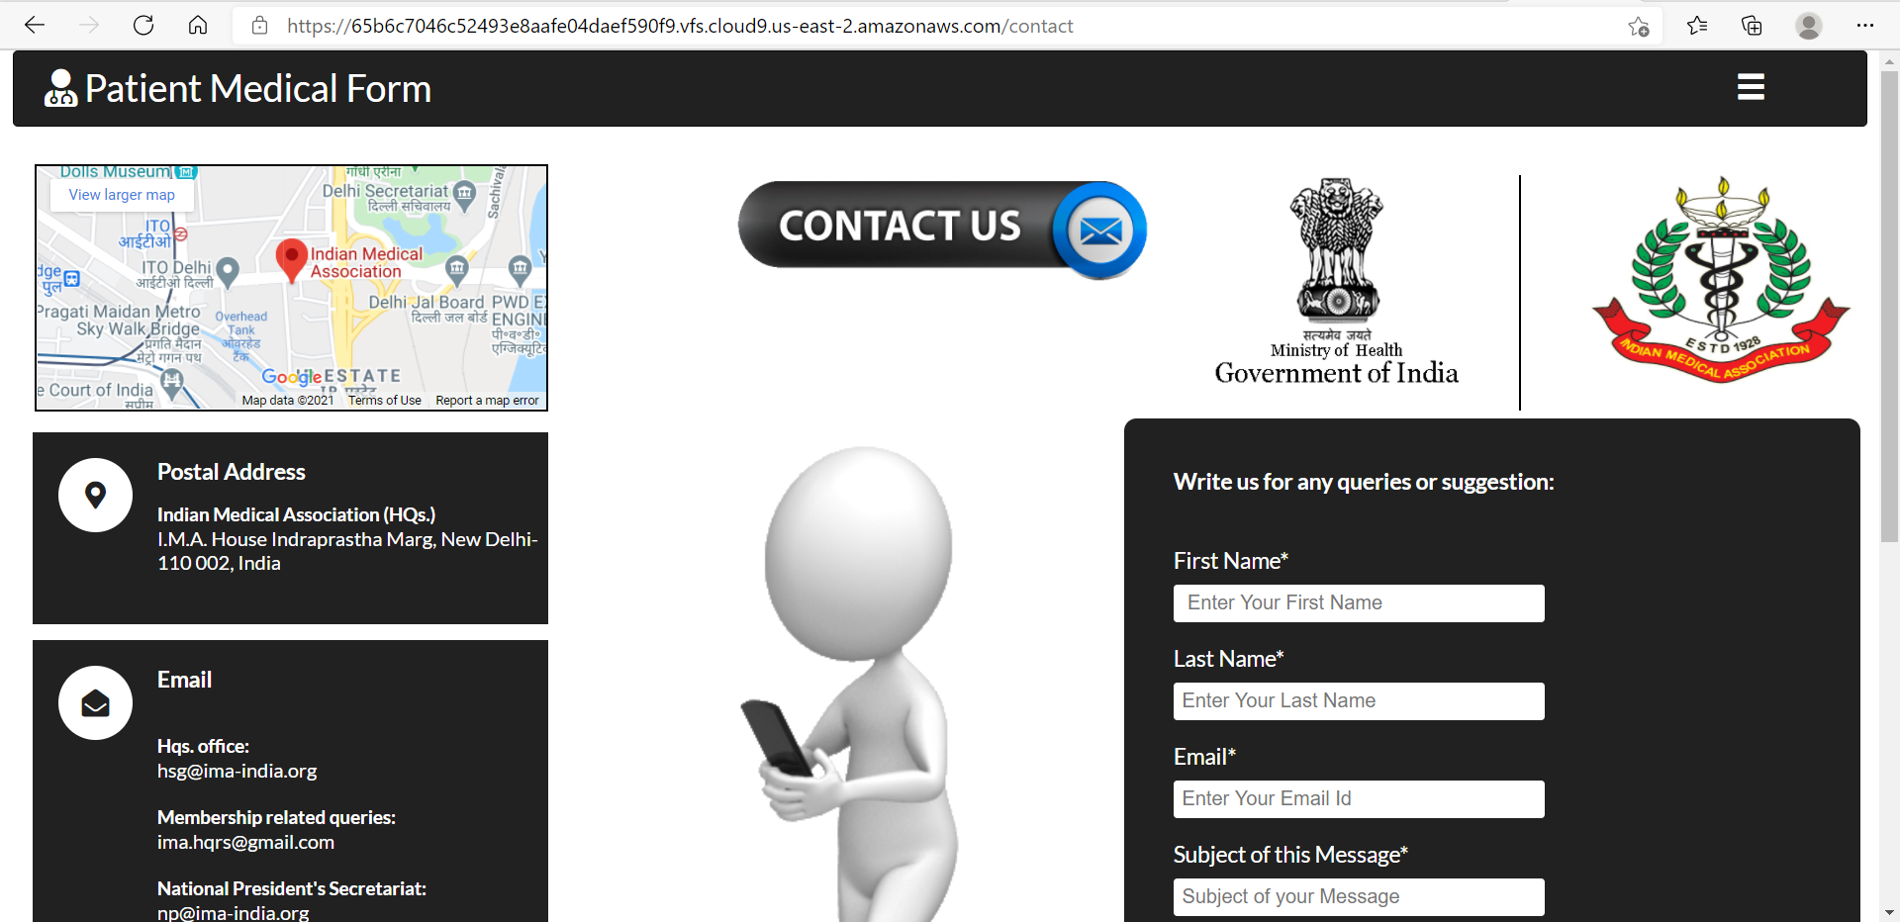

Slide 13
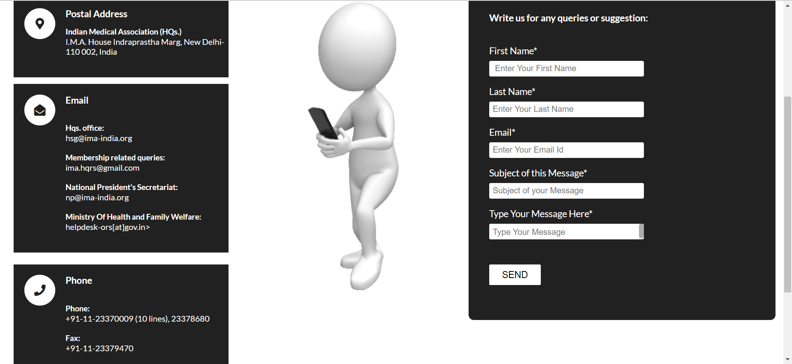

Slide 14
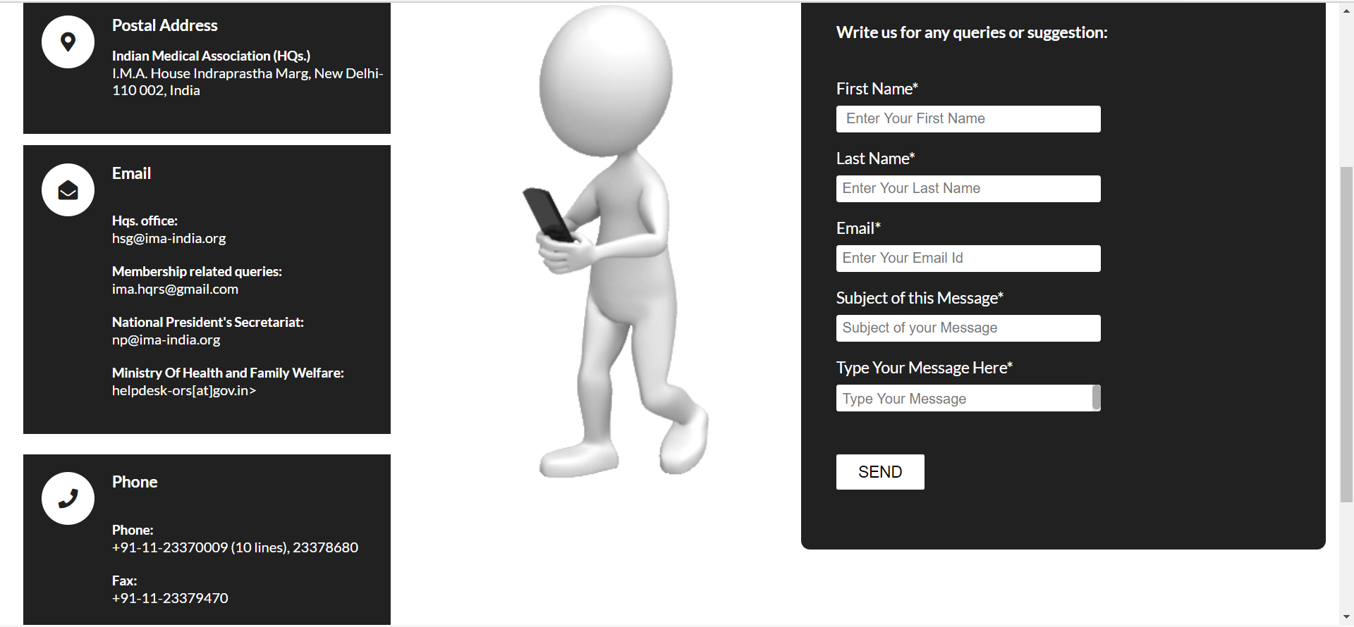

Slide 15
